Slide 1
2018 report figures/stats

Slide 2
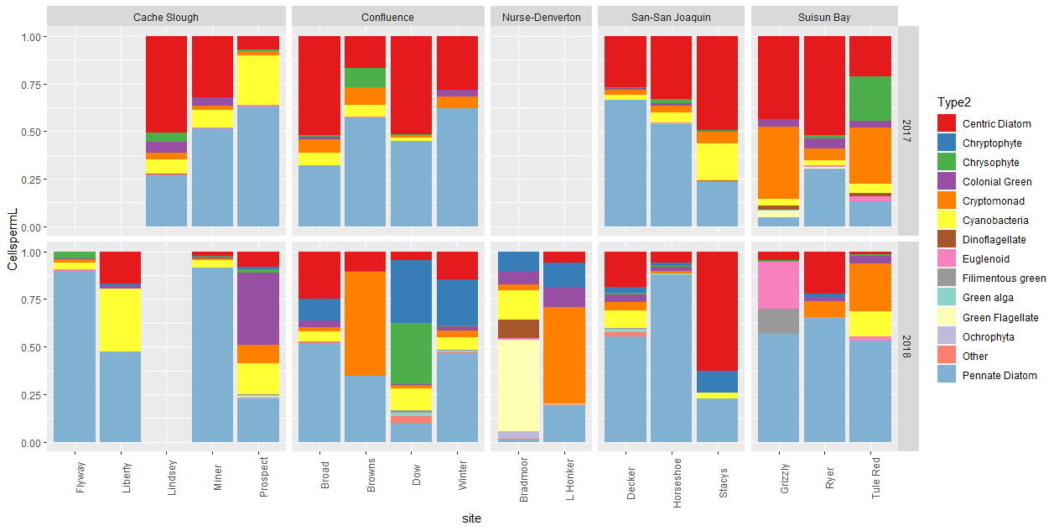
Phytoplankton – community composition by site

Slide 3
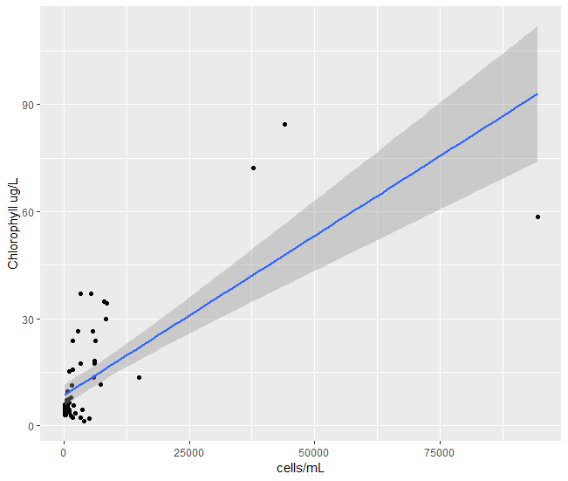
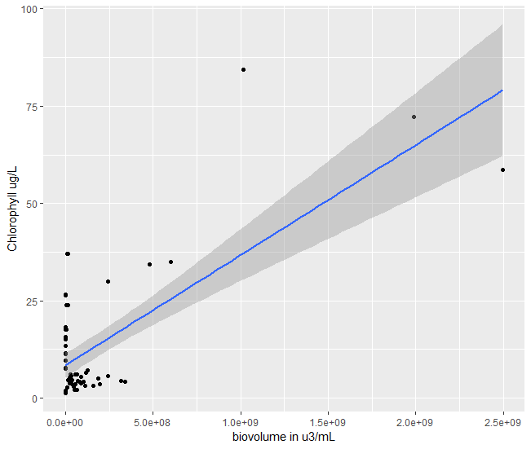
Association between CHL and cell counts
y = ?
I’m having issues with this model, but it’s not good anyway.
y = 0.00046x + 7.63
R2 = 0.215
P <0.0001

Slide 4
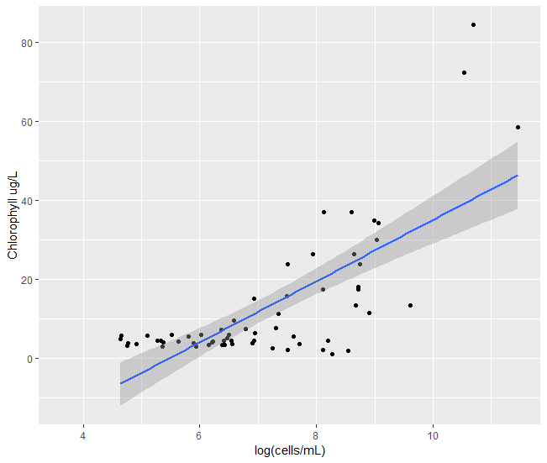
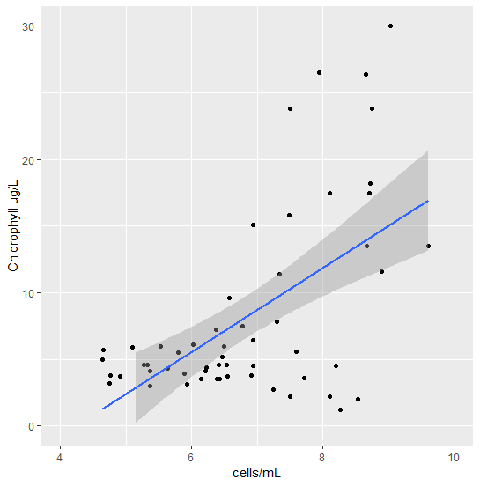
Association between CHL and cell counts - log
All values
CHL <30
Y = 7.74x -42.3
R2= 0.535
P < 0.0001
Y = 2.77x -11.03
R2 = 0.296
P < 0.0001
Notes:
It’s definitely less significant at low values, but not as bad as it could be.

Slide 5
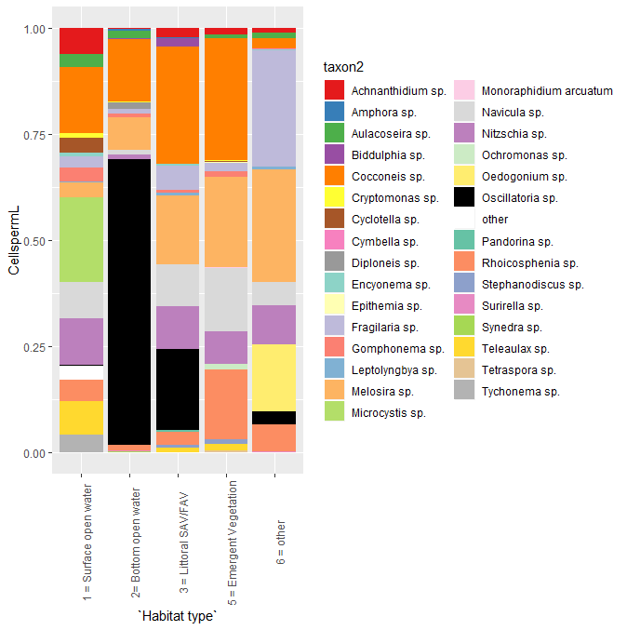
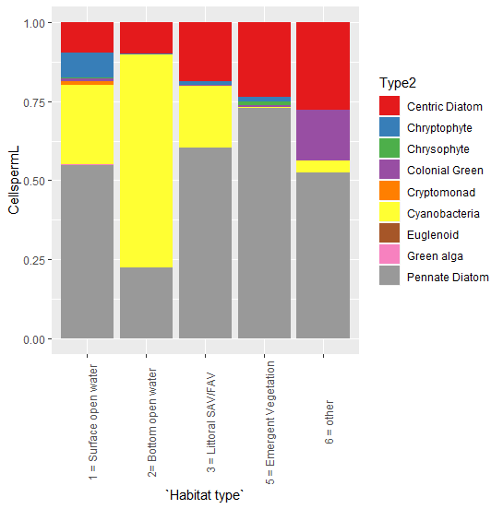
Phytoplankton – Liberty habitats

Slide 6
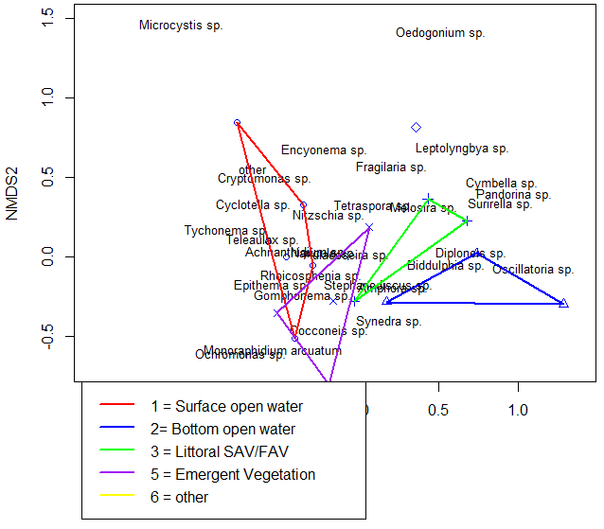
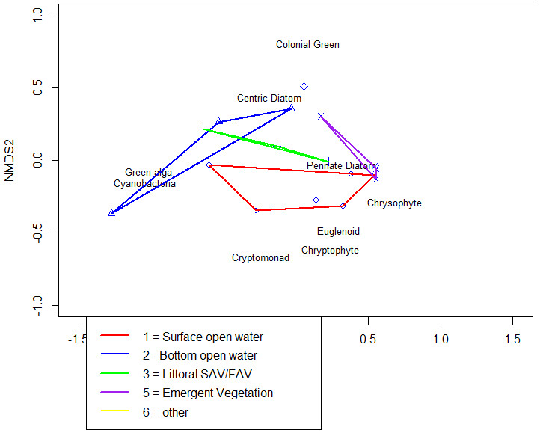
Phytoplankton – Liberty habitats
Taxon Names
Larger taxonomic groups
The “other” habitat was filamentous algae

Slide 7
Phytoplankton – Liberty habitats
Associations between species and habitat types at Liberty Island
 | Pelagic | Benthic | SAV/FAV | Tules | best | psidak
Achnanthidium sp. | 0.005 | 0.995 | 0.665 | 0.67 | Pelagic | 0.019851
Cryptomonas sp. | 0.005 | 0.815 | 1 | 0.605 | Pelagic | 0.019851
Cyclotella sp. | 0.005 | 1 | 1 | 0.85 | Pelagic | 0.019851
other | 0.005 | 0.815 | 0.86 | 1 | Pelagic | 0.019851
Teleaulax sp. | 0.005 | 0.98 | 0.79 | 0.735 | Pelagic | 0.019851
Gomphonema sp. | 0.015 | 0.585 | 0.99 | 0.485 | Pelagic | 0.058663
Rhoicosphenia sp. | 0.415 | 0.995 | 0.575 | 0.035 | Tules | 0.13282
Cocconeis sp. | 0.605 | 0.705 | 0.73 | 0.04 | Tules | 0.150653
Monoraphidium arcuatum | 0.300 | 1 | 1 | 0.045 | Tules | 0.16821
Diploneis sp. | 0.62 | 0.05 | 1 | 1 | Benthic | 0.185494
Aulacoseira sp. | 0.5 | 0.055 | 0.83 | 0.655 | Benthic | 0.202506
Nitzschia sp. | 0.07 | 0.985 | 0.16 | 0.7 | Pelagic | 0.251948
Biddulphia sp. | 1 | 0.37 | 0.075 | 1 | SAV/FAV | 0.267906
Oscillatoria sp. | 0.975 | 0.08 | 0.215 | 0.965 | Benthic | 0.283607
Amphora sp. | 0.705 | 0.09 | 0.735 | 0.55 | Benthic | 0.31425
Leptolyngbya sp. | 0.625 | 1 | 0.105 | 1 | SAV/FAV | 0.358359
Synedra sp. | 0.64 | 0.105 | 1 | 1 | Benthic | 0.358359
Navicula sp. | 0.28 | 0.99 | 0.355 | 0.115 | Tules | 0.386559
Melosira sp. | 0.965 | 0.315 | 0.13 | 0.605 | SAV/FAV | 0.427102
Pandorina sp. | 1 | 1 | 0.18 | 1 | SAV/FAV | 0.547878
Tetraspora sp. | 1 | 1 | 1 | 0.185 | Tules | 0.558805
Cymbella sp. | 1 | 0.205 | 1 | 1 | Benthic | 0.600544
Surirella sp. | 1 | 0.205 | 0.325 | 1 | Benthic | 0.600544
Epithemia sp. | 0.235 | 0.515 | 1 | 0.235 | Pelagic | 0.657512
Ochromonas sp. | 1 | 1 | 1 | 0.235 | Tules | 0.657512
Encyonema sp. | 0.34 | 0.43 | 0.24 | 1 | SAV/FAV | 0.666378
Fragilaria sp. | 0.845 | 0.475 | 0.255 | 0.34 | SAV/FAV | 0.691947
Tychonema sp. | 0.335 | 1 | 1 | 1 | Pelagic | 0.804437
Stephanodiscus sp. | 1 | 0.345 | 0.525 | 0.365 | Benthic | 0.815938
Microcystis sp. | 0.385 | 1 | 1 | 1 | Pelagic | 0.856946

Slide 8
Phytoplankton – Liberty habitats
I want to see if I can map other samples onto the Liberty NMDS to see where they fall in the benthic/pelagic community.
Need to run some PerMANOVAs

Slide 9
Decker Time series
I need to grab updated salmon and smelt data
I need to zooplankton data too.
Compare to EMP
Compare to flow.
Notes:
We took some sweep nets in September of 2017 for the aquatic veg study.
This is strange and obnoxious. I don’t know what to do about it.

Slide 10
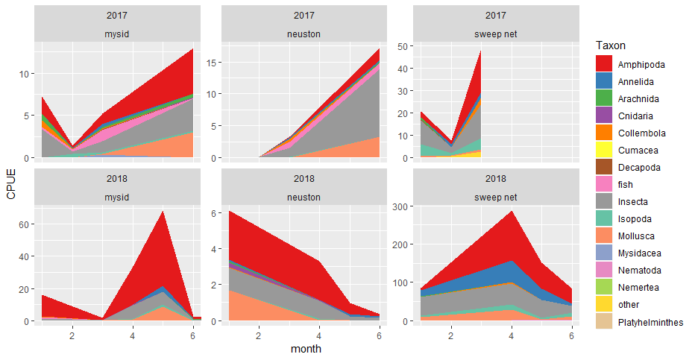
Decker Time series
Notes:
We took some sweep nets in September of 2017 for the aquatic veg study.
This is strange and obnoxious. I don’t know what to do about it.

Slide 11
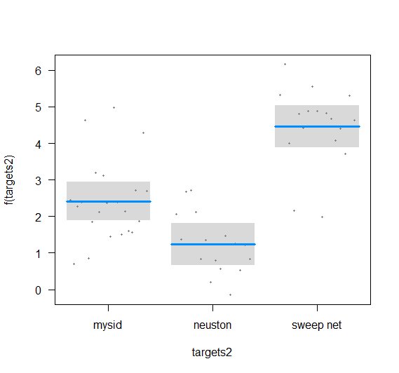
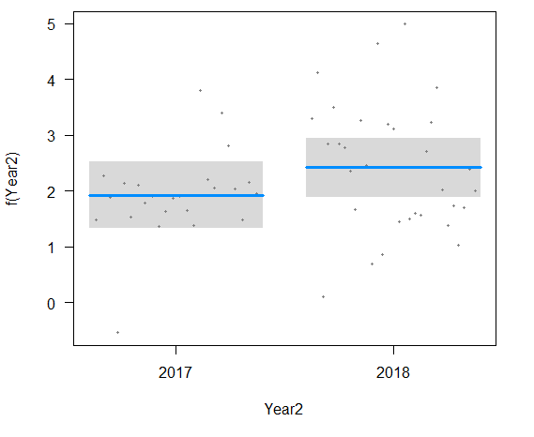
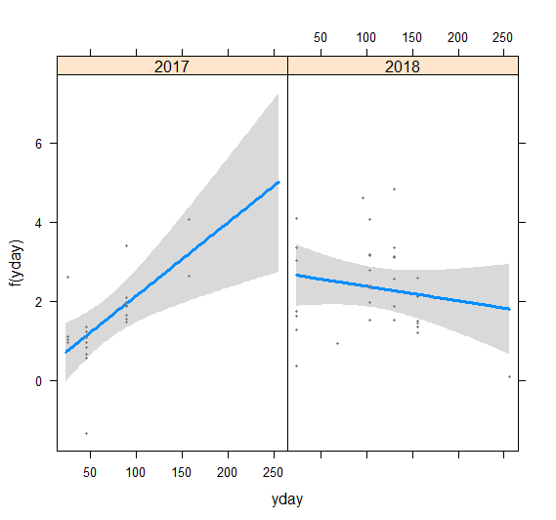
Decker Time series
log(tCPUE + 1) ~ Geartype + JulianDay*Year
 | Estimate | Std. Error | t value | Pr(>|t|)
(Intercept) | 0.284 | 0.481 | 0.591 | 0.557
Gear: neuston | -1.174 | 0.351 | -3.343 | 0.002 | **
Gear: sweep net | 2.042 | 0.341 | 5.985 | 0.000 | ***
Julian Day | 0.018 | 0.006 | 3.114 | 0.003 | **
Year | 2.458 | 0.619 | 3.968 | 0.000 | ***
Julian Day * Year2018 | -0.022 | 0.007 | -3.186 | 0.003 | **
Notes:
Without the interaction the Julian day is not significant

Slide 12
Channel/shallow time series
Our zooplankton samples aren’t done yet
EMP’s zooplankton data should be available by next week
Notes:
May want a quadratic for month.

Slide 13
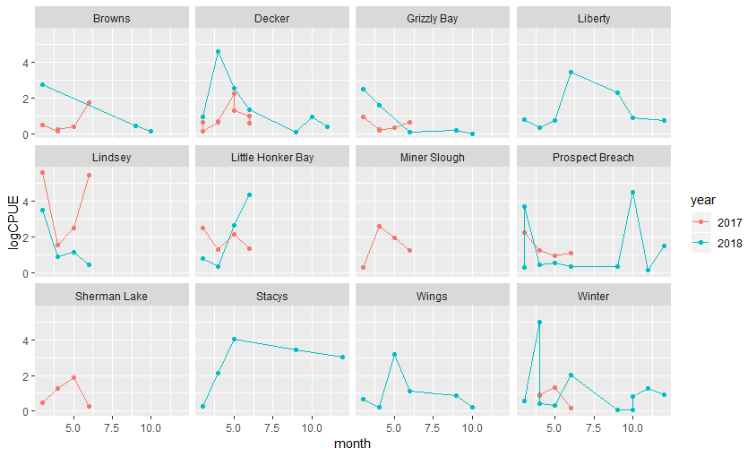
Channel/shallow time series - mysids
Notes:
May want a quadratic for month.

Slide 14
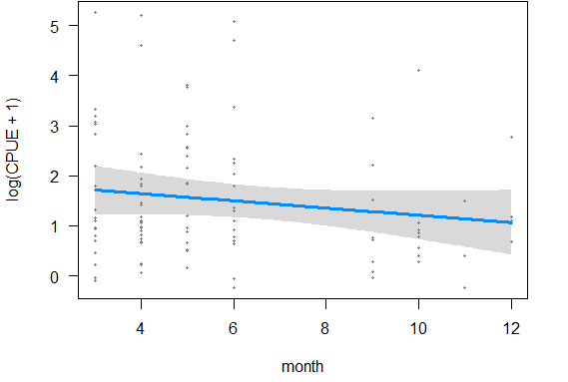
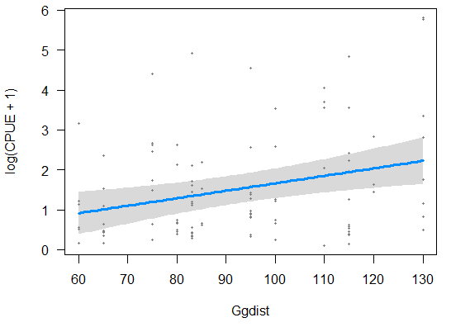
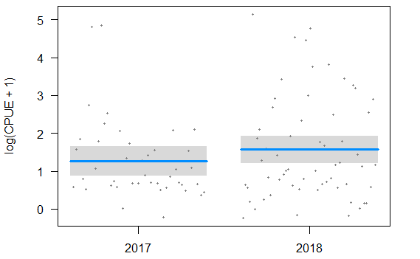
Channel/shallow time series - mysids
log(CPUE + 1) ~ month + Ggdist + year
 | Estimate | Std. Error | t value | Pr(>|t|)
(Intercept) | -0.151 | 0.640 | -0.236 | 0.814
month | -0.072 | 0.052 | -1.394 | 0.166
Ggdist | 0.019 | 0.006 | 3.070 | 0.003 | **
year2018 | 0.304 | 0.274 | 1.112 | 0.269
Notes:
May want a quadratic for month.

Slide 15
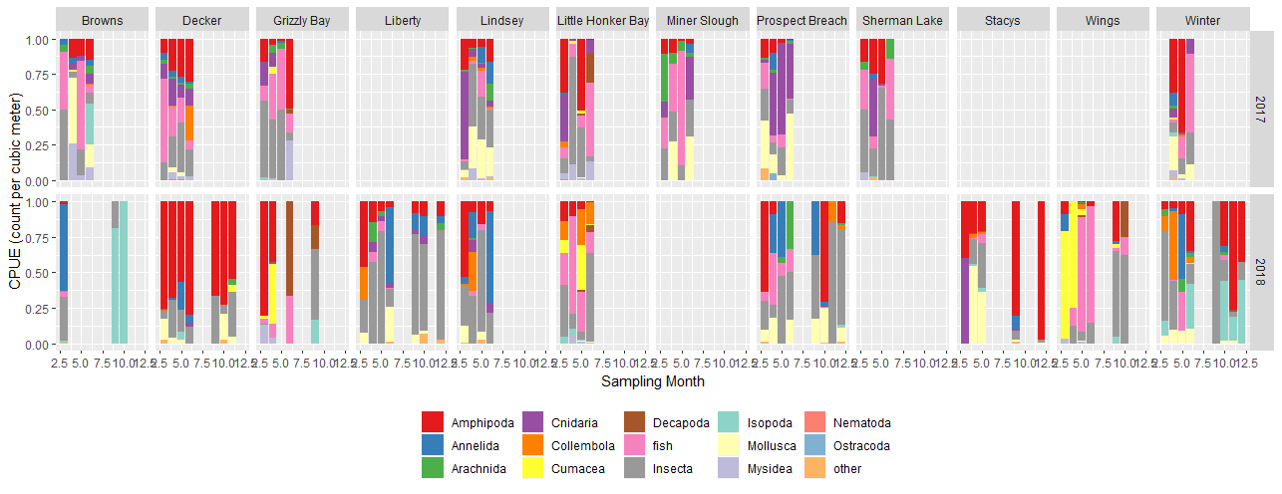
Channel/shallow time series - mysids
Notes:
May want a quadratic for month.

Slide 16
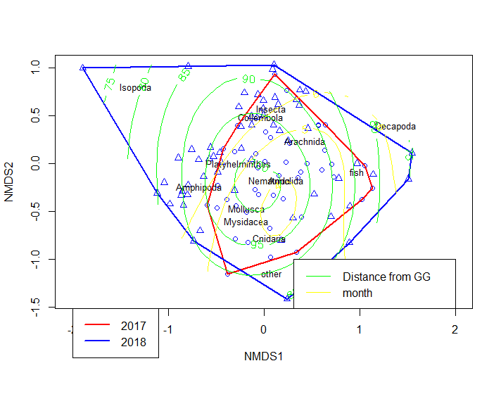
Channel/shallow time series - mysids
 | Df | SumsOfSqs | MeanSqs | F.Model | R2 | Pr(>F)
month | 1 | 0.9149 | 0.91491 | 4.2082 | 0.03712 | 0.001 | ***
Ggdist | 1 | 1.4958 | 1.49577 | 6.8798 | 0.06068 | 0.001 | ***
year | 1 | 0.9332 | 0.93318 | 4.2922 | 0.03786 | 0.003 | **
Residuals | 98 | 21.3065 | 0.21741 |  | 0.86435
Total | 101 | 24.6504 |  |  | 1

Slide 17
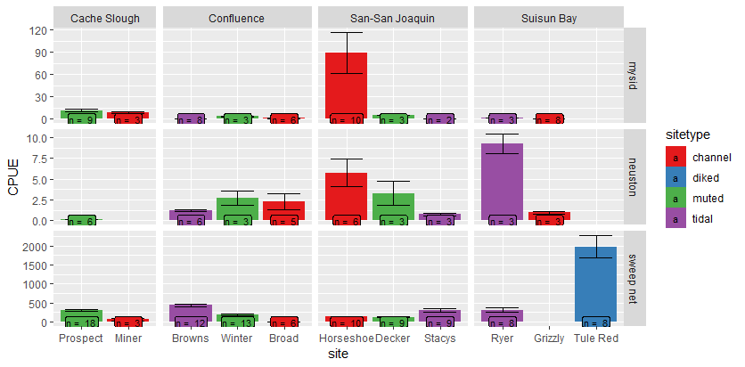
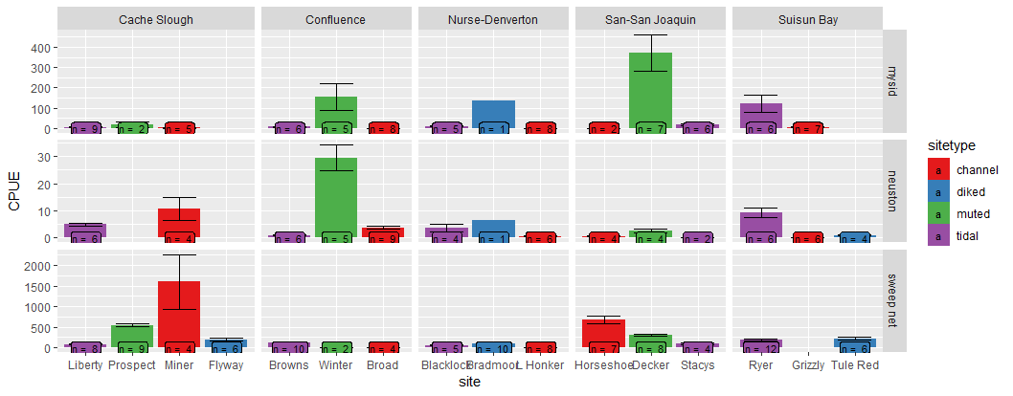
Macroinvertebrate blitz, total CPUE
2017
2018

Slide 18
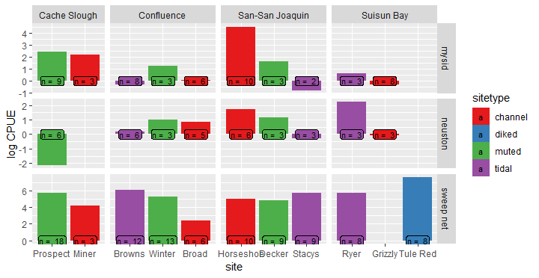
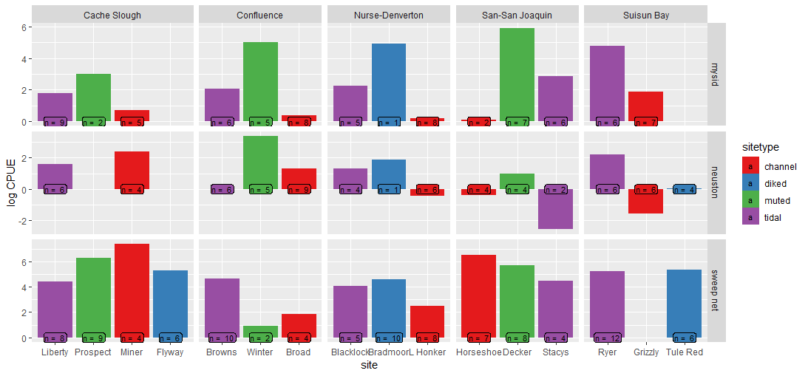
CPUE –log transformed
2017
2018

Slide 19
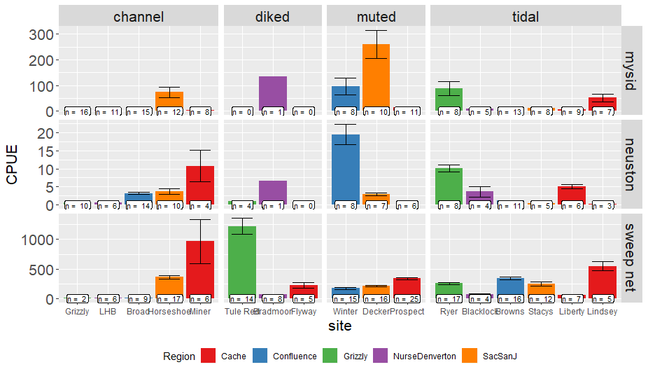
CPUE – both years together

Slide 20
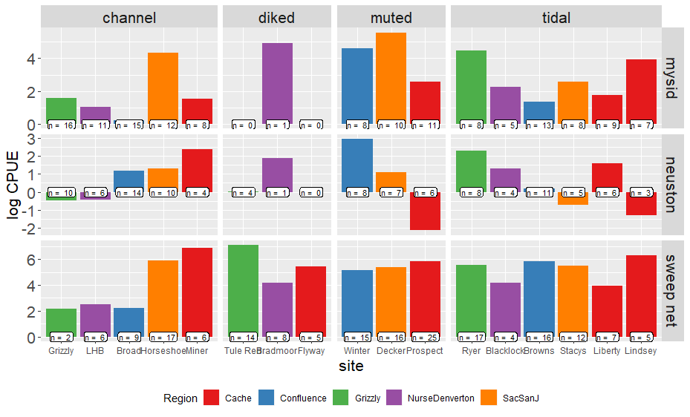
CPUE – log-transformed

Slide 21
Macroinvert blitz GLMM
Log(CPUE+1) ~ Gear + sitetype + Error(Site)
 | Estimate | Std. Error | df | t value | Pr(>|t|)
(Intercept: Channel, mysids) | 1.1574 | 0.223 | 15.7878 | 5.19 | <0.0001 | ***
Sitetype: diked | 1.0441 | 0.3741 | 21.252 | 2.791 | 0.01087 | *
Sitetype: muted | 1.0029 | 0.3307 | 10.8019 | 3.032 | 0.01162 | *
Sitetype: tidal | 0.4462 | 0.2935 | 11.6847 | 1.52 | 0.15498
Gear: neuston | -0.5131 | 0.1804 | 429.1981 | -2.844 | 0.00467 | **
Gear: sweep net | 2.7004 | 0.1613 | 435.1671 | 16.741 | < 0.0001 | ***
Post-hoc shows wetland sites have higher catch overall from channel sites, but wetlands are not different from each other.
Earlier analyses with AIC did not support use of Year or Region as predictor variables

Slide 22
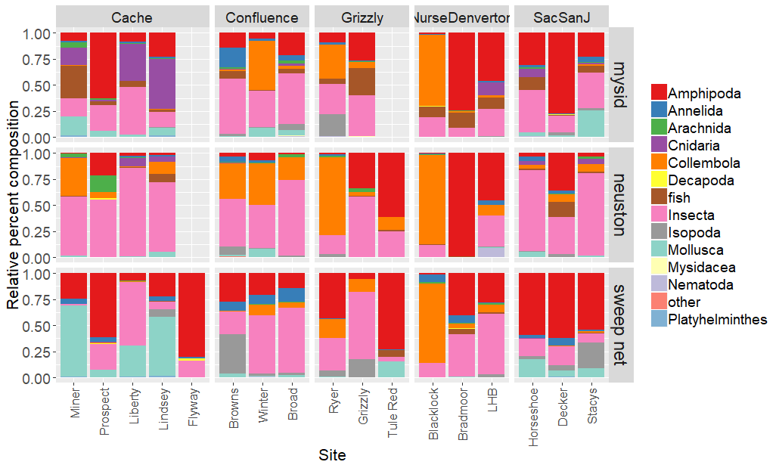
Macroinvert blitz
Notes:
Separate by year?

Slide 23
Macroinverts Multivariates
Permanova
 | Df | SumsOfSqs | MeanSqs | F.Model | R2 | Pr(>F)
Region | 4 | 6. 861 | 1.715 | 11.305 | 0.073 | 0.001 | ***
SiteType | 3 | 8.527 | 2.841 | 18.733 | 0.091 | 0.001 | ***
Habitat | 2 | 7.960 | 3.979 | 26.232 | 0.0849 | 0.001 | ***
site | 9 | 7.629 | 0.848 | 5.587 | 0.081 | 0.001 | ***
Residuals | 414 | 62.811 | 0.152 |  | 0.669
Total | 432 | 93.79 |  |  | 1

Slide 24
NMDS issues
I can’t get it to converge with two years of data at all the sites
One year at a time?
Average by site?
Just show NMDSs for the pairwise comparisons?
Show non-convergent solution?

Slide 25
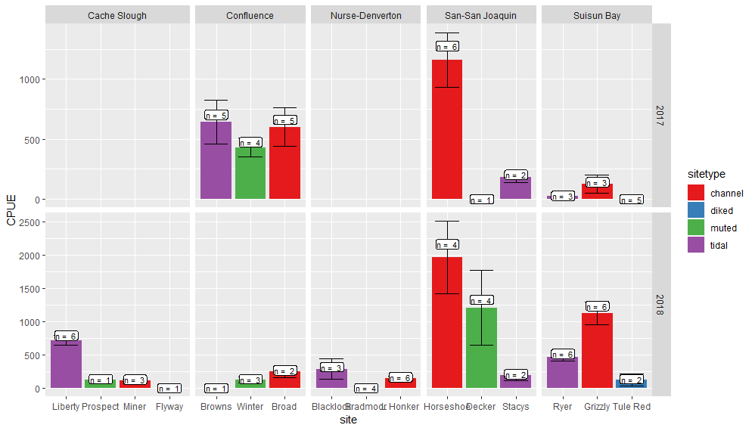
Clams
Since we changed the way we processed benthic samples this year, I’m planning on a separate analysis just of invasive clams

Slide 26
Clam logCPUE
LogCPUE ~ sitetype + Region + Year + error(site)
Best model via AICc
 | Estimate | Std. Error | df | t value | Pr(>|t|)
(Intercept) | 4.791 | 1.028 | 23.387 | 4.662 | 0.000 | ***
sitetypediked | -4.609 | 0.925 | 7.982 | -4.980 | 0.001 | **
sitetypemuted | -1.642 | 0.905 | 7.409 | -1.815 | 0.110
sitetypetidal | -0.891 | 0.673 | 6.502 | -1.323 | 0.230
Region2Confluence | -0.225 | 1.071 | 14.446 | -0.210 | 0.837
Region2Nurse-Denverton | -1.499 | 1.039 | 12.275 | -1.444 | 0.174
Region2San-San Joaquin | 0.464 | 1.028 | 11.876 | 0.451 | 0.660
Region2Suisun Bay | -0.018 | 0.963 | 9.218 | -0.019 | 0.985
Year22018 | 1.276 | 0.582 | 75.740 | 2.193 | 0.031 | *

Slide 27
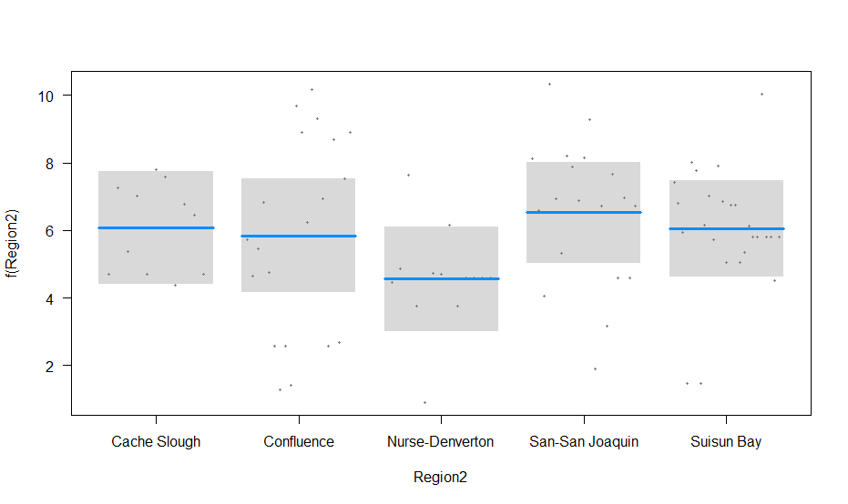
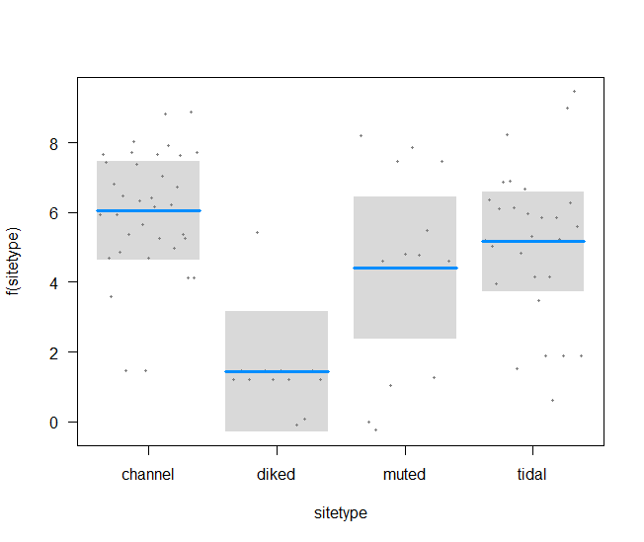
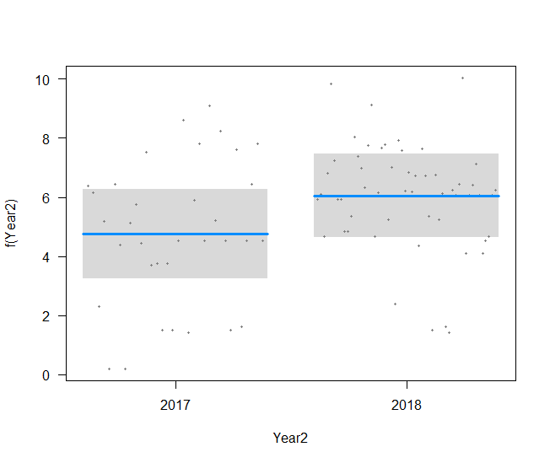
Clams
NS
A
A
A
B
B
A

Slide 28
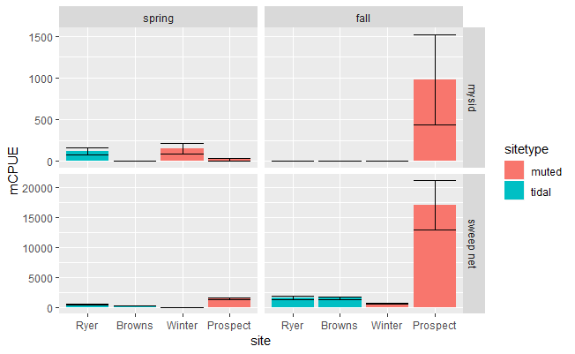
Spring versus Fall – macroinverts CPUE

Slide 29
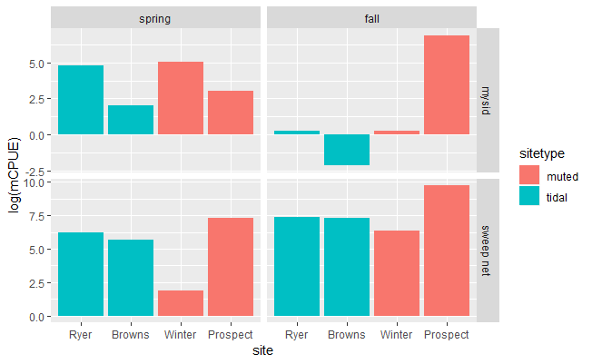
Log-transformed CPUE

Slide 30
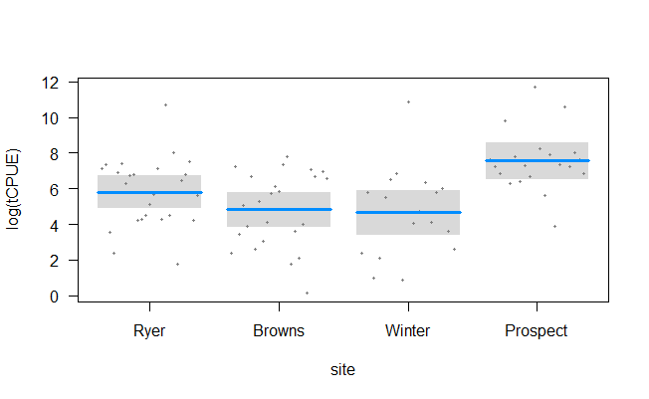
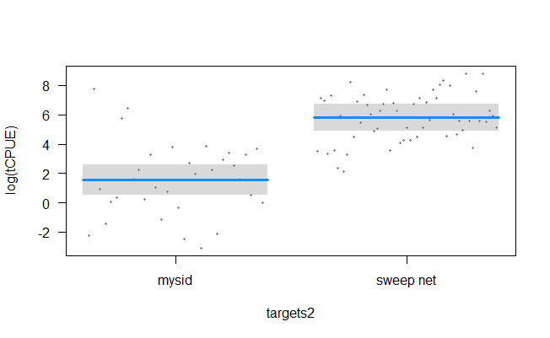
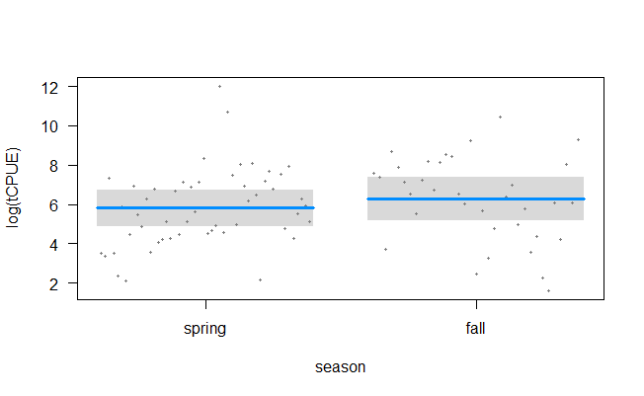
Spring versus Fall - macroinverts
 | Estimate | Std. Error | t value | Pr(>|t|)
(Intercept – mysid, ryer, spring) | 1.563 | 0.528 | 2.959 | 0.004 | **
Site: Browns | -0.999 | 0.589 | -1.698 | 0.093 | .
Site: Winter | -1.157 | 0.674 | -1.718 | 0.090 | .
Site: Prospect | 1.748 | 0.630 | 2.775 | 0.007 | **
Gear: sweep | 4.250 | 0.470 | 9.037 | 0.000 | ***
Season: fall | 0.471 | 0.466 | 1.011 | 0.315
C
B
A
AB
NS
B
A

Slide 31
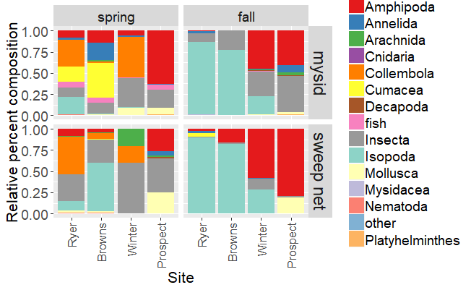
Spring v Fall multivariates

Slide 32
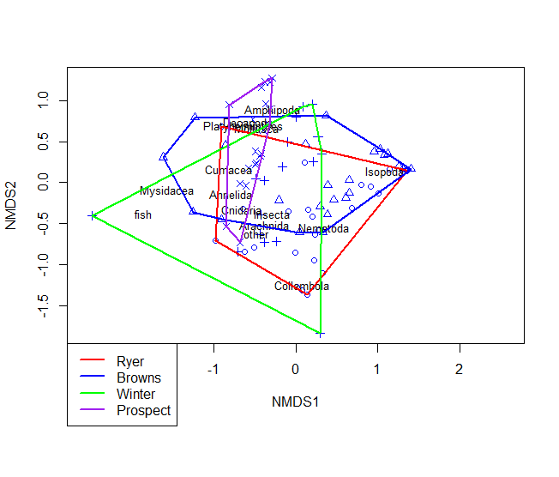
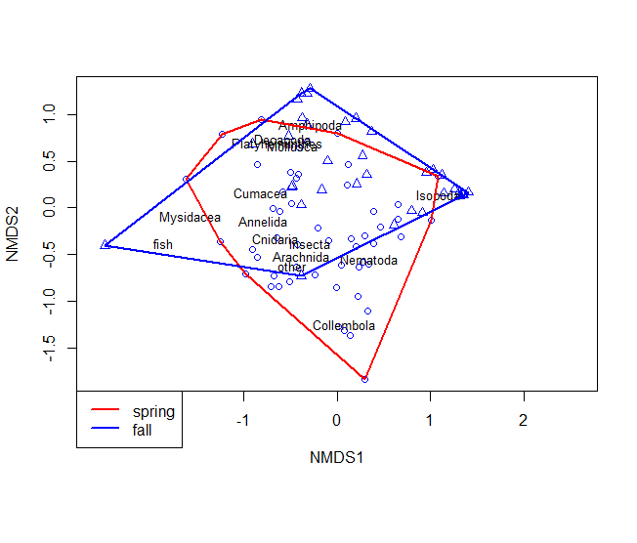
Spring v Fall PErmanova
 | Df | SumsOfSqs | MeanSqs | F.Model | R2 | Pr(>F)
Site | 3 | 5.6911 | 1.897 | 11.1194 | 0.24275 | 0.001 | ***
Gear | 1 | 0.7332 | 0.7332 | 4.2978 | 0.03128 | 0.002 | **
season | 1 | 3.2007 | 3.2007 | 18.7607 | 0.13652 | 0.001 | ***
Residuals | 81 | 13.8191 | 0.1706 |  | 0.58945
Total | 86 | 23.4442 |  |  | 1

Slide 33
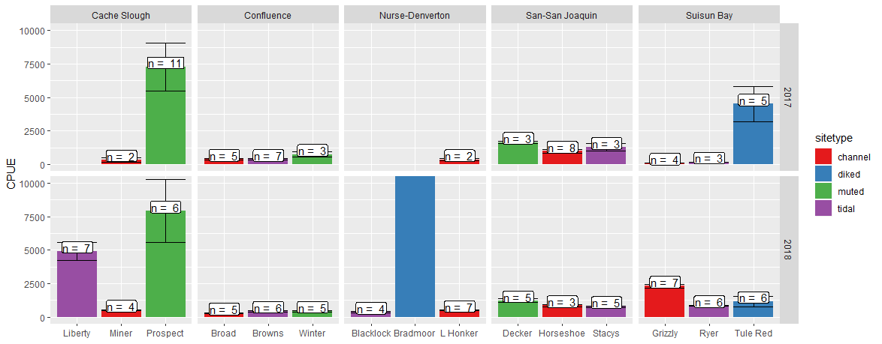
Zooplankton CPUE – spring blitz
CPUE = 135,198
N = 6
Notes:
We haven’t sorted all the fall samples yet.

Slide 34
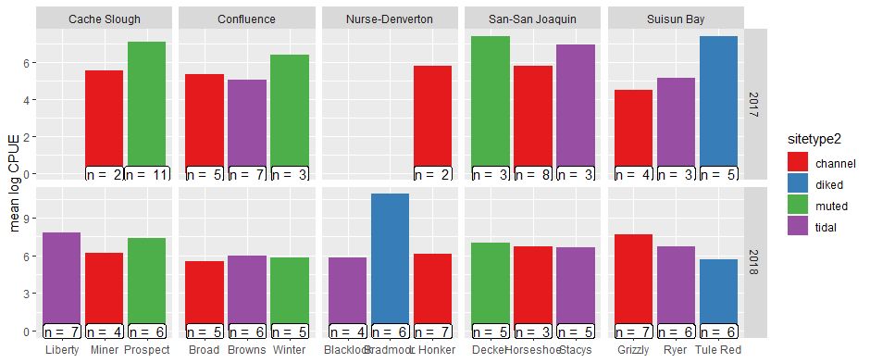
Zooplankton log cpue

Slide 35
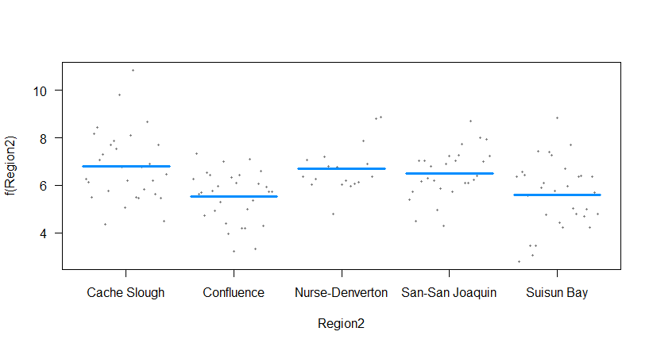
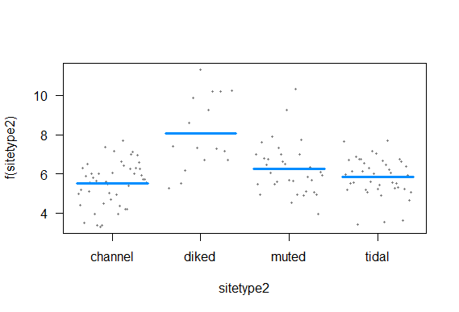
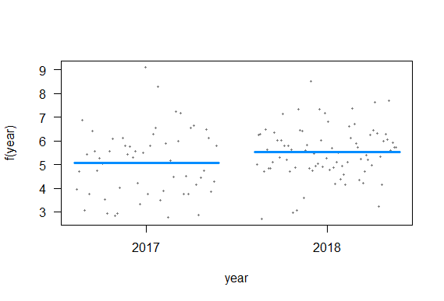
Log(CPUE)~ Region + sitetype + year + Error(site)
 | Estimate | Std. Error | df | t value | Pr(>|t|)
(Intercept – Cache, channel, 2017) | 6.345 | 0.788 | 7.414 | 8.057 | 0.000 | ***
Region - Confluence | -1.281 | 0.888 | 6.462 | -1.444 | 0.196
Region - Nurse-Denverton | -0.102 | 1.005 | 7.256 | -0.101 | 0.922
Region - San-San Joaquin | -0.283 | 0.892 | 6.584 | -0.317 | 0.761
Region - Suisun Bay | -1.200 | 0.983 | 6.651 | -1.221 | 0.264
Sitetype - diked | 2.560 | 1.009 | 6.623 | 2.537 | 0.041 | *
Sitetype - muted | 0.737 | 0.841 | 6.456 | 0.876 | 0.412
Sitetype - tidal | 0.330 | 0.695 | 6.739 | 0.475 | 0.650
year2018 | 0.451 | 0.245 | 124.870 | 1.839 | 0.068 | .
NS
B
NS
A
A
A
Notes:
I tried just looking at the 2018 data, and removing Bradmoor, but none of that helped.
Should I try just calanoid copepods?

Slide 36
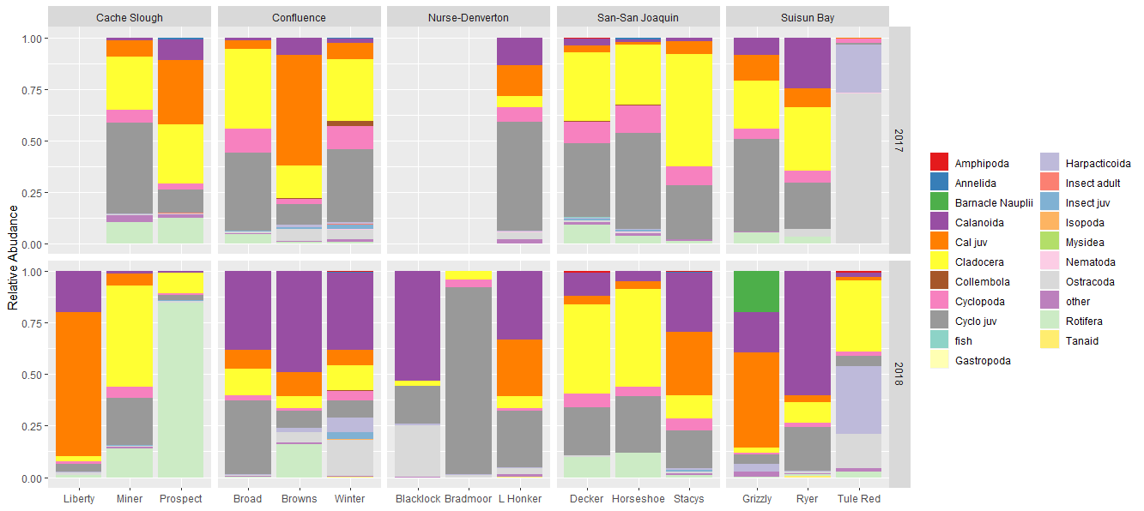
Zooplankton

Slide 37
Zooplankton Permanova
 | Df | SumsOfSqs | MeanSqs | F.Model | R2 | Pr(>F)
Region2 | 4 | 4.687 | 1.17174 | 7.8249 | 0.1566 | 0.001 | ***
sitetype2 | 3 | 4.3552 | 1.45173 | 9.6946 | 0.14551 | 0.001 | ***
year | 1 | 1.5705 | 1.57051 | 10.4878 | 0.05247 | 0.001 | ***
Residuals | 129 | 19.3172 | 0.14975 |  | 0.64542
Total | 137 | 29.9299 |  |  | 1
Notes:
No convergent solutions on NMDS

Slide 38
Pairwise comparisons
I need to add zooplankton and clam graphs to some of the comparisons
I want to add DWR’s yolo bypass toedrain data, maybe USFWS zooplankton data from Liberty.
Should I subset just “fish food” critters? It seems as though the more we learn the more we find all fish eat whatever is there.

Slide 39
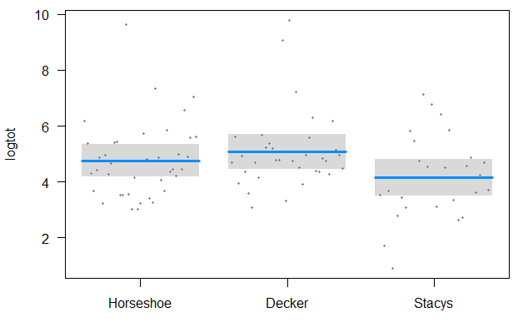
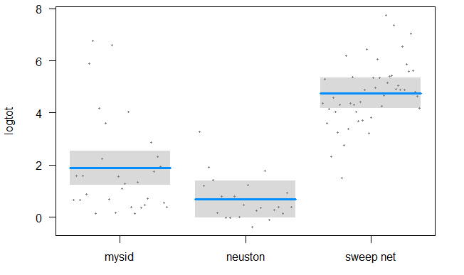
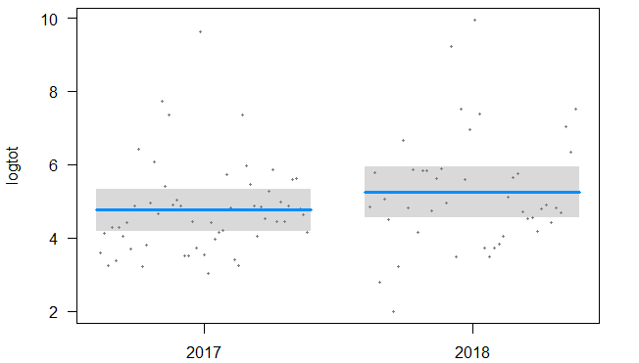
Stacy’s v Decker v Horseshoe bend
Macroinvert blitz
A
C
AB
B
A
B
ANOVA of log total CPUE
NS
 | Df | Sum Sq | Mean Sq | F value | Pr(>F)
site | 2 | 15.26 | 7.63 | 3.74 | 0.0274 | *
Geartype | 2 | 291.85 | 145.92 | 71.54 | <2e-16 | ***
Year2 | 1 | 5.46 | 5.46 | 2.675 | 0.1053
Residuals | 93 | 189.7 | 2.04

Slide 40
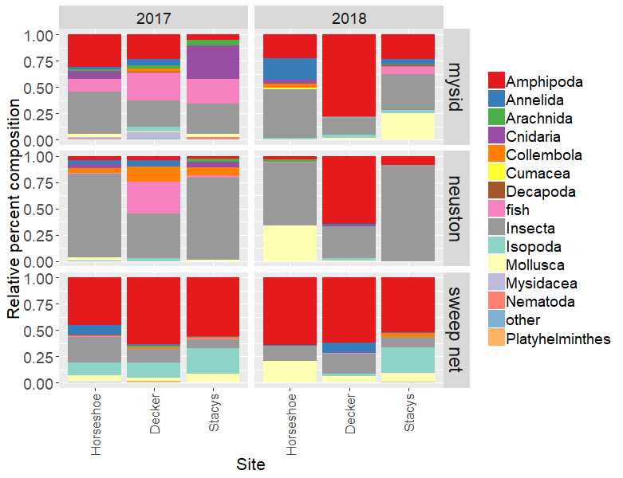
PERMANOVA
Stacy’s v Decker v Horseshoe bend
Macroinvert blitz
 | Df | SumsOfSqs | MeanSqs | F.Model | R2 | Pr(>F)
site | 2 | 1.46 | 0.73417 | 5.7648 | 0.081 | 0.001 | ***
Year | 1 | 0.70 | 0.70782 | 5.5579 | 0.039 | 0.004 | **
Geartype | 2 | 4.04 | 2.02407 | 15.8933 | 0.224 | 0.001 | ***
Residuals | 93 | 11.84 | 0.12735 |  | 0.655
Total | 98 | 18.06 |  |  | 1

Slide 41
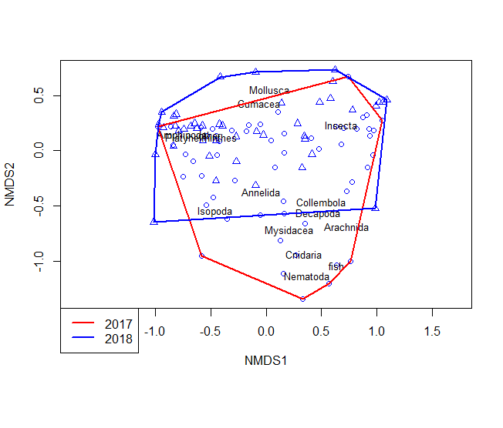
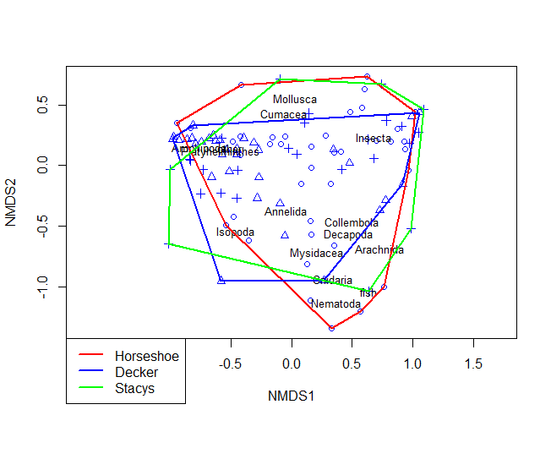

NMDS
Stacy’s v Decker v Horseshoe bend
Macroinvert blitz

Slide 42



Clams
Stacy’s v Decker v Horseshoe bend
CLAMS anova
 | Df | Sum Sq | Mean Sq | F value | Pr(>F)
site | 2 | 24.89 | 12.443 | 2.423 | 0.122
Year | 1 | 4.47 | 4.465 | 0.87 | 0.366
Residuals | 15 | 77.02 | 5.134

Slide 43


Zooplankton log(CPUE)~ site + year
Stacy’s v Decker v Horseshoe bend
Zooplankton Anova
 | Df | Sum Sq | Mean Sq | f value | Pr(>F)
site | 2 | 5.583 | 2.7915 | 2.356 | 0.117
year | 1 | 0.035 | 0.0355 | 0.03 | 0.864
Residuals | 23 | 27.252 | 1.1849

Slide 44



Zooplankton blitz Permanova and NMDS
Stacy’s v Decker v Horseshoe bend
NMDS stress = 0.1198
Zooplankton PERMANOVA
 | Df | SumsOfSqs | MeanSqs | F.Model | R2 | Pr(>F)
site | 2 | 0.563 | 0.281 | 3.464 | 0.204 | 0.001 | ***
year | 1 | 0.333 | 0.333 | 4.095 | 0.120 | 0.002 | **
Residuals | 23 | 1.868 | 0.081 |  | 0.676
Total | 26 | 2.764 |  |  | 1.000

Slide 45



Liberty v Prospect v Miner v Flyway
Macroinvert blitz
B
A
B
A
B
A
B
 | Df Sum Sq Mean Sq F | value | Pr(>F)
site | 3 50.09 16.70 | 9.057 | 2.87E-05 | ***
Geartype | 2 229.95 114.97 | 62.367 | < 2e-16 | ***
Year | 1 13.58 13.58 | 7.364 | 0.00806 | **
Residuals | 85 156.70 1.84
A
A

Slide 46

Liberty v Prospect v Miner v Flyway
Macroinvert blitz
Df SumsOfSqs MeanSqs F.Model | R2 Pr(>F)
site 3 3.7805 1.26016 9.0941 | 0.20452 0.001 | ***
Year 1 0.4823 0.48233 3.4808 | 0.02609 0.019 | *
Gear 2 2.4431 1.22156 8.8155 | 0.13217 0.001 | ***
Residuals 85 11.7784 0.13857 | 0.63721
Total 91 18.4843 | 1
---

Slide 47



Liberty v Prospect v Miner v Flyway
Macroinvert blitz

Slide 48

Liberty v Prospect v Miner v Flyway
Clams
Log(CPUE)~ site
 | Df | Sum Sq | Mean Sq | f value | Pr(>F)
site | 3 | 33.86 | 11.287 | 9.875 | 0.00656 | **
Residuals | 7 | 8 | 1.143
A
Tukey post-hoc
ABC
AB
 | diff | lwr | upr | p adj
Prospect-Liberty | -1.380 | -5.203 | 2.442 | 0.648
Miner-Liberty | -1.501 | -4.004 | 1.001 | 0.278
Flyway-Liberty | -6.203 | -10.025 | -2.380 | 0.004
Miner-Prospect | -0.121 | -4.207 | 3.965 | 1.000
Flyway-Prospect | -4.823 | -9.828 | 0.182 | 0.058
Flyway-Miner | -4.702 | -8.788 | -0.615 | 0.027
C

Slide 49


Zooplankton blitz log(CPUE) ~ site + year
Liberty v Prospect v Miner
zooplankton anova
 | Df | Sum Sq | Mean Sq | f value | Pr(>F)
site | 2 | 10.95 | 5.473 | 2.207 | 0.13
year | 1 | 0.64 | 0.643 | 0.259 | 0.615
Residuals | 26 | 64.48 | 2.48
Notes:
I need to add Yolo zoops for Flyway

Slide 50



Zooplankton blitz
Liberty v Prospect v Miner
NMDS stress = 0.155
 | Df | SumsOfSqs | MeanSqs | F.Model | R2 | Pr(>F)
site | 2 | 1.3683 | 0.68416 | 4.6267 | 0.24396 | 0.002 | **
year | 1 | 0.3958 | 0.39577 | 2.6764 | 0.07056 | 0.027 | *
Residuals | 26 | 3.8447 | 0.14787 |  | 0.68548
Total | 29 | 5.6088 |  |  | 1

Slide 51



Browns v Winter v Broad Slough
Macroinvert blitz
A
A
NS
B
B
 | Df | Sum Sq | Mean Sq | F value | Pr(>F)
site | 2 | 74.48 | 37.24 | 20.704 | 2.28E-08 | ***
Gear | 2 | 182.1 | 91.05 | 50.622 | 2.38E-16 | ***
Year2 | 1 | 0.14 | 0.14 | 0.076 | 0.783
Residuals | 111 | 199.64 | 1.8
A
A

Slide 52

Browns v Winter v Broad Slough
Macroinvert blitz
permanova
 | Df | SumsOfSqs | MeanSqs F | F.Model | R2 | p
site | 2 | 3.2208 | 1.6104 | 10.1315 | 0.13156 | 0.001
Year | 1 | 0.8169 | 0.8169 | 5.1393 | 0.03337 | 0.001
Gear | 2 | 2.8 | 1.40002 | 8.8079 | 0.11438 | 0.001
Residuals | 111 | 17.6435 | 0.15895 |  | 0.72069
Total | 116 | 24.4812 |  |  | 1

Slide 53



Macroinvert blitz

Slide 54



Grizzly v Ryer v Tule Red
Macroinvert blitz
C
C
A
A
B
B
 | Df | Sum Sq | Mean Sq | f value | Pr(>F)
site | 2 | 189.09 | 94.54 | 43.39 | <0.001 | ***
Gear | 2 | 112.56 | 56.28 | 25.83 | <0.001 | ***
Year2 | 1 | 0.48 | 0.48 | 0.22 | 0.641
Residuals | 74 | 161.24 | 2.18
NS

Slide 55

Grizzly v Ryer v Tule Red
Macroinvert blitz
 | Df | SumsOfSqs | MeanSqs | F.Model | R2 | Pr(>F)
site | 2 | 5.969 | 2.984 | 16.879 | 0.269 | 0.001 | ***
Year | 1 | 0.387 | 0.387 | 2.189 | 0.017 | 0.063 | .
Gear | 2 | 2.757 | 1.378 | 7.795 | 0.124 | 0.001 | ***
Residuals | 74 | 13.084 | 0.177 |  | 0.589
Total | 79 | 22.196 |  |  | 1.000

Slide 56



Grizzly v Ryer v Tule Red
Macroinvert blitz

